Slide 1



Academic Advisement
Pre-Registration Forum
Academic
Probation
Withdrawal from Module
Credit
Limits
Transfer of Credits
Exemption
Regulation
3
ADD/DROP
Student
Handbook
Module Selection
Academic
Advisor
College Academic Advisement Unit (CAAU)
College of Health Sciences
University of Technology, Jamaica

Slide 2
Objectives of the Academic Advisement Session
Define key terms relevant to Academic Advisement (AA).
Introduce the members of the College Academic Advisement Unit (CAAU) from the College of Health Sciences.
Outline the role of the CAAU.
Summarize the role of the Academic Advisor (lecturer).
Summarize the role of the Academic Advisee (student).
Summarize Regulation 3 and polices.
State important time-bound activities and their associated forms.

Slide 3
College Academic Advisement Unit
(CAAU), COHS
Members of the Committee
Caribbean School of Nursing (CSON)
Mr. Abubakar Usman, Montego Bay Campus
School of Allied Health & Wellness (SAHW)
School of Pharmacy (SOP)
Mrs. Deneise Walters, Papine Campus
Prof. Sonia Richards-Malcolm
Mrs. Tieca Harris Kidd
Dr. Janice Bunting-Clarke
Dr. Stephanie Mullings
Dr. Peta-Gaye Thomas-Brown (Chair)
Ms. Sophia Walters, Papine Campus
Mrs. Valdean Davis-Harris
Ms. Gillian Mignott
Ms. Lisa Scarlett
Mr. Kemar Bundy

Slide 4
Role of the College Academic Advisement Unit
(CAAU)
Assign students (Academic advisees) to an Academic Advisor (Staff)
Link Advisors to Advisees on the Student Portal
Facilitate Training of Staff
Facilitate Student Advisement Session
E.g. Pre-Registration Forum
Manage Academic Advisement within the College

Slide 5
Key Terms Relevant to Academic Advisement (AA)

Slide 6
1. What is Academic Advisement ?
Academic advisement is a structured support system available to every student when making important academic decisions related to his/her course
Available options
Electives
General academic progress

Slide 7
2. Who is an Academic Advisee ?
A registered student at the University

Slide 8

3. Who is a Registered Student?
A student will be considered “registered” when he or she has:
Accepted the offer of admission and paid the commitment fee by the stipulated date
Select Modules (Using Module Selection Guide)
Paid all fees and charges prescribed by the University by the stipulated date
Agreed to the terms and conditions governing the University

Slide 9
2. Who is an Academic Advisor ?
A lecturer assigned to the Academic Unit (College/Course of study)

Slide 10
You can view the name of your assigned academic advisor on your Student Portal!
How to view the name of your assigned Academic Advisor
Academic Advisor

Slide 11

If you are unable to reach your Academic Advisor or do not know their name, email the following persons:
A. College Student Affairs Representative with the following information:
1. Your Name (First and Surname)
2. ID #
3. Name of your Course of Study
4. Year you started the course
B. You may also reach out to your:
- Programme Director or CAAU Representative (Specific for your School/Course)
Who should I contact when I do not know my Academic Advisor?

Slide 12
College of Health Sciences Student Affairs Representatives
(COHS Front Desk)
COHS Student Affairs Representatives | Contact Information
Ms. Tanique Soares Ms. Kareen Facey | Tanique.soares@utech.edu.jm Ext. 3794 Kareen.facey@utech.edu.jm Ext. 3795

Slide 13
Reach out to the CAAU Representatives for your School
Schools | CAAU Representatives | Contact Information
School of Allied Health and Wellness (SAHW) | Professor Sonia Richards-Malcolm | soanrichmalcolm@utech.edu.jm Ext. 3788
 | Mrs. Valdean Davis-Harris | valdean.davis-harris@utech.edu.jm Ext. 2321
 | Mr. Kemar Bundy | kemar.bundy@utech.edu.jm Ext.
 | Ms. Lisa Scarlett | lscarlett@utech.edu.jm Ext. 3471
 | Ms. Gillian Mignott | gmignott@utech.edu.jm Ext. 3451
School of Pharmacy (SOP) | Dr. Peta-Gaye Thomas-Brown, Chair | pthomas-brown@utech.edu.jm Ext. 3456
 | Dr. Stephanie Mullings | Stephanie.mullings@utech.edu.jm Ext. 3453
 | Dr. Janice Bunting Clarke | Janice.Bunting-Clark@utech.edu.jm Ext. 3450
 | Mrs. Tieca Harris Kidd | tharris@utech.edu.jm Ext. 3782
Caribbean School of Nursing (CSON) | Montego Bay Campus Mr. Abubakar Usman Papine Campus | Abubakar.Usman@utech.edu.jm Ext. 2754
 | Mrs. Deneise Walters Ms. Sophia Smith | deneise.walters@utech.edu.jm Ext. 3240 sophia.smith@utech.edu.jm Ext. 3244
CAAU Committee Members, COHS

Slide 14
5. What are Policies?
A set of Guidelines approved by the University

Slide 15
1
Explain the features of Regulation 3
2
Establish Communication with Assigned Advisees
3
Provide guidance related to academic problems considering University Expectations
4
Provide assistance in deciding how to meet the demands of the course and module
5
Monitor Progress of Students on Academic Probation (GPA<2.0)
6
Explain Academic Policies & Implications
Role of the Academic Advisor
7
Understanding the Implications and Applications of Regulation

Slide 16
THINGS TO DISCUSS WITH YOUR ADVISOR
General University Matters
Module Diet for course of study
Grade forgiveness
Add/drop
Registration
Transfer of credit or academic records
Financial status
Services provided by Institution e.g. financial, Counseling etc.
Leave of absence
Withdrawal from Course of Study
Withdrawal from module
Independent study
Grade point average/grading policy
Request for Transfer
Advance Placement

Slide 17
THINGS TO DISCUSS WITH YOUR ADVISOR
Course of Study Specific Matters
Selection of modules
Clashing of Module(s)
Failure of module(s)
Elective(s)
Academic probation
Redo of module(s)
Academic session(Semester 1, Semester 2 and Summer)

Slide 18
THINGS TO DISCUSS WITH YOUR ADVISOR
Other
Issues
Change of academic advisor
Build academic relationship
Explanation of academic policies/requirements/
expectations
Addressing academic demands
Monitor progress
Initial meeting

Slide 19


1
Read the Student Handbook and be familiar with the policies and expectations
2
Seek to understand the Implications and Applications of Regulation 3
3
See Handbook for Student Responsibilities
e.g. Class attendance, Dress Code
4
Establish Communication with your Assigned Advisor
5
Seek assistance when navigating issues surrounding a module /course (demands)
Role of the Academic Advisee (Student)
6
If on Academic Probation ensure module selection is under the guidance of your Academic Advisor and Programme Director

Slide 20
Student Handbook
Summary of Academic Polices

Slide 21
The Enrolment Process
1. Select and Confirm Modules and/or class times specific to course of study
Visit the University webpage: Colleges and Faculties https://www.utech.edu.jm/academics/academics/colleges-faculties 2. Module Selection Guides are Uploaded for each course of study or will be provided by your School 3. Challenges you may experience: Modules Full Clashes Credit Limits (E.g. Academic Probation) 4. Speak with your Academic Advisor

Slide 22
The Enrolment Process
2. Select and Confirm Modules and/or class times specific to course of study
Pay the required fees Speak with the Finance Department and establish your payment plan
3. Receive Financial Clearance
4. Agree with terms and conditions
5. Complete medical
6. Collect identification cards

Slide 23
Student Handbook
Summary of Key Concepts under Regulation 3

Slide 24
Summary of Key Concepts under Regulation 3
Transfer of Credit
Exemptions
Add/Drop
Withdrawal from Module
Withdrawal from Course of Study
Request for Transfer from a course of study to another
Grade Forgiveness
Independent Study

Slide 25

Transfer of Credit
A transfer credit is earned for a module successfully completed in an approved tertiary institution and deemed equivalent to the module to be undertaken in your course of study.
There is no fee cost for modules for which a Transfer of Credit has been approved
Transfer credits are not calculated in the GPA, but will appear on the record
Notes:
A transcript should be attached to the submission , Maximum credit transfer 50% , credits remaining to be done at level 3 and 4 is at least 60%
Policy- Page 216

Slide 26
Transfer of Credit
Class of Awards in light of Transfer of Credit:
The number of transfer of credit may affect eligibility for certain classes of awards
First Class or Upper Second class honours:
Transfer students must complete at least 80 % or 70 % of the full course of study
Notes:
A transcript should be attached to the submission , Maximum credit transfer 50% , credits remaining to be done at level 3 and 4 is at least 60%
Policy- Page 216

Slide 27
Transfer of Credit
Procedure: Complete the Transfer of Credit Form and attach supporting document
Have an official transcript from the transfer institution mailed directly to the Office of the Registrar at least four (4) weeks prior to the start of the semester in which the Applicant will be enrolled.
Notes:
Policy Page 218 Exemptions are not calculated as part of the GPA
Students are expected to complete at least 50% of course of student , including 60% at level 3 and 4 to receive a University award. Module/ or work experience should be completed within the last 5 years for exemption to be granted.
Fees to be paid for exempted modules

Slide 28
Exemptions
This is:
a) the award of credits for workplace or
professionally certified experience where the
learning outcomes are deemed equivalent to
those prescribed in the UTech module
b) the award of credits for equivalent module successfully pursued at an approved institution, which were not considered during the initial application to the course of study.
Notes:
Policy Page 218 Exemptions are not calculated as part of the GPA
Students are expected to complete at least 50% of course of student , including 60% at level 3 and 4 to receive a University award. Module/ or work experience should be completed within the last 5 years for exemption to be granted.
Fees to be paid for exempted modules

Slide 29
Exemptions
An exemption will be recorded on the student’s transcript (including the number of credits recognized)
The number of exemptions may affect the class of award
Fees to be paid for exemptions:
(Student Financial Service of Handbook) – Pay the associated cost assigned to the module
Notes:
Policy Page 218 Exemptions are not calculated as part of the GPA
Students are expected to complete at least 50% of course of student , including 60% at level 3 and 4 to receive a University award. Module/ or work experience should be completed within the last 5 years for exemption to be granted.
Fees to be paid for exempted modules

Slide 30
Exemptions
Procedure: Complete the Module Exemption form (Available at the Faculty/College Student Affairs Office)
Submit along with supporting documents no later than two (2) weeks prior to the start of the semester in which the exemption is being sought
Student should attend classes until the exemption is granted
Notes:
Policy Page 218 Exemptions are not calculated as part of the GPA
Students are expected to complete at least 50% of course of student , including 60% at level 3 and 4 to receive a University award. Module/ or work experience should be completed within the last 5 years for exemption to be granted.
Fees to be paid for exempted modules

Slide 31

Add/Drop
Online Add/drop electronic procedure
Allows you to submit the request form from anywhere that there is internet access
Form can only be accessed by “Registered” students (online)
Complete online form and submit by the end of second week of Semester 1 and 2 and first five (5) working days of the Summer Session.
Tutorial video is available online
Reminder
Email your Programme Director to notify him/her that you have requested an Add/Drop

Slide 32
Withdrawal from Module
Intended to assist students who are insufficiently prepared to complete and be examined in a module
Student discuss with the academic advisor
Time: Must be done no less than 2 weeks before the official suspension of classes for the Semester or the summer session

Slide 33
Request for transfer to change course of study
Application should be submitted to Programme
Director six (6) weeks before the beginning
of the Semester using the Request for
Transfer form.

Slide 34
Grade Forgiveness (GF)
Is an opportunity for a student to redo a module in which a grade of C- or lower was received and earn a grade that will be substituted for the previous grade
Cannot be used for modules involving core/specialization, academic misconduct and capstone projects

Slide 35
Grade Forgiveness (GF)
Both grades will remain in the students record
Limited to a maximum of 12 credits in an undergraduate degree
Failure in light of GF – the GF grade will be used to calculate the GPA, and he/she must redo the module

Slide 36
Grade Forgiveness (GF)
Procedure:
a)Discuss with Academic advisor
b) Complete “Application Form for Grade Forgiveness.” (Student Affairs’ Office)
c) Submission: to the Programme Director within two (2) weeks of the start of the semester or summer session in which the module is to be redone

Slide 37
Independent Study (IS)
IS may be taken as a project, a module or as a modality for the completion of a required course of study.
It will be based on the discretion of the Faculty/College concerned.

Slide 38
RESOURCES & SUPPORT
AVAILABLE TO YOU

Slide 39

Support System within your Course of Study
Student Service Representative within the College
Academic Advisor
Class Tutor
Academic Managers
(Programme Director, Head of School, Vice Dean, Dean)
Remember to follow the communication channel

Slide 40
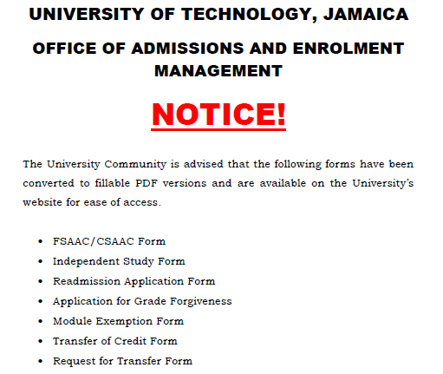
Services & Forms
Available Online
Please click on link below to access forms.
https://www.utech.edu.jm/forms

Slide 41
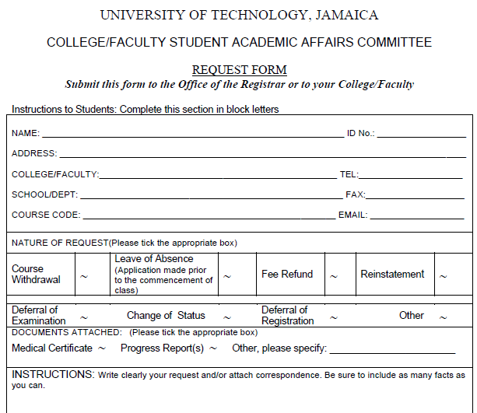
Services & Forms
Available Online
Sample CSAAC FORM
Please click on link below to access forms.
https://www.utech.edu.jm/forms

Slide 42
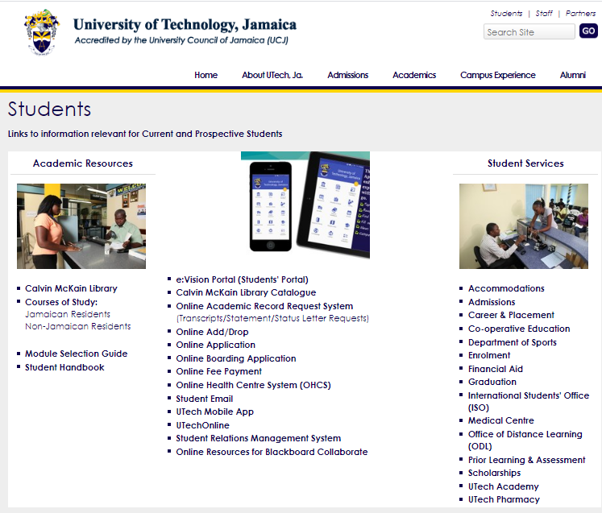
Services & Forms
Available Online
ADD/DROP
https://www.utech.edu.jm/students

Slide 43

….and all the best with your Academic Journey!
CAAU – College of Health Sciences

